Slide 1
Milestone 4
Shiru Hou
Mohammed AlHabsi
Yaqeen AlKathiri
Shreyas Ugemuge

Slide 2
Progress
Added new behaviors
Decide on data mining tools to use
Modify merge program
Readable Output models
Split data for training and testing
Complete GUI Design

Slide 3
Behaviors
Total number of unit discussions
Number of fluency drill activities
Number of crosswords attended (terminology)
Number of game shows attended (terminology)
Number of final exam reviews
Pre-course assessment duration
Duration of practice exam
Duration of time between practice exam and final
Duration of time between final review and starting the final

Slide 4
Data Mining Tools
1- Weka
2- RapidMiner
3- Python
numpy
sklearn

Slide 5
Modify Merge Program
provide output according to the DM tools’ input requirement

Slide 6
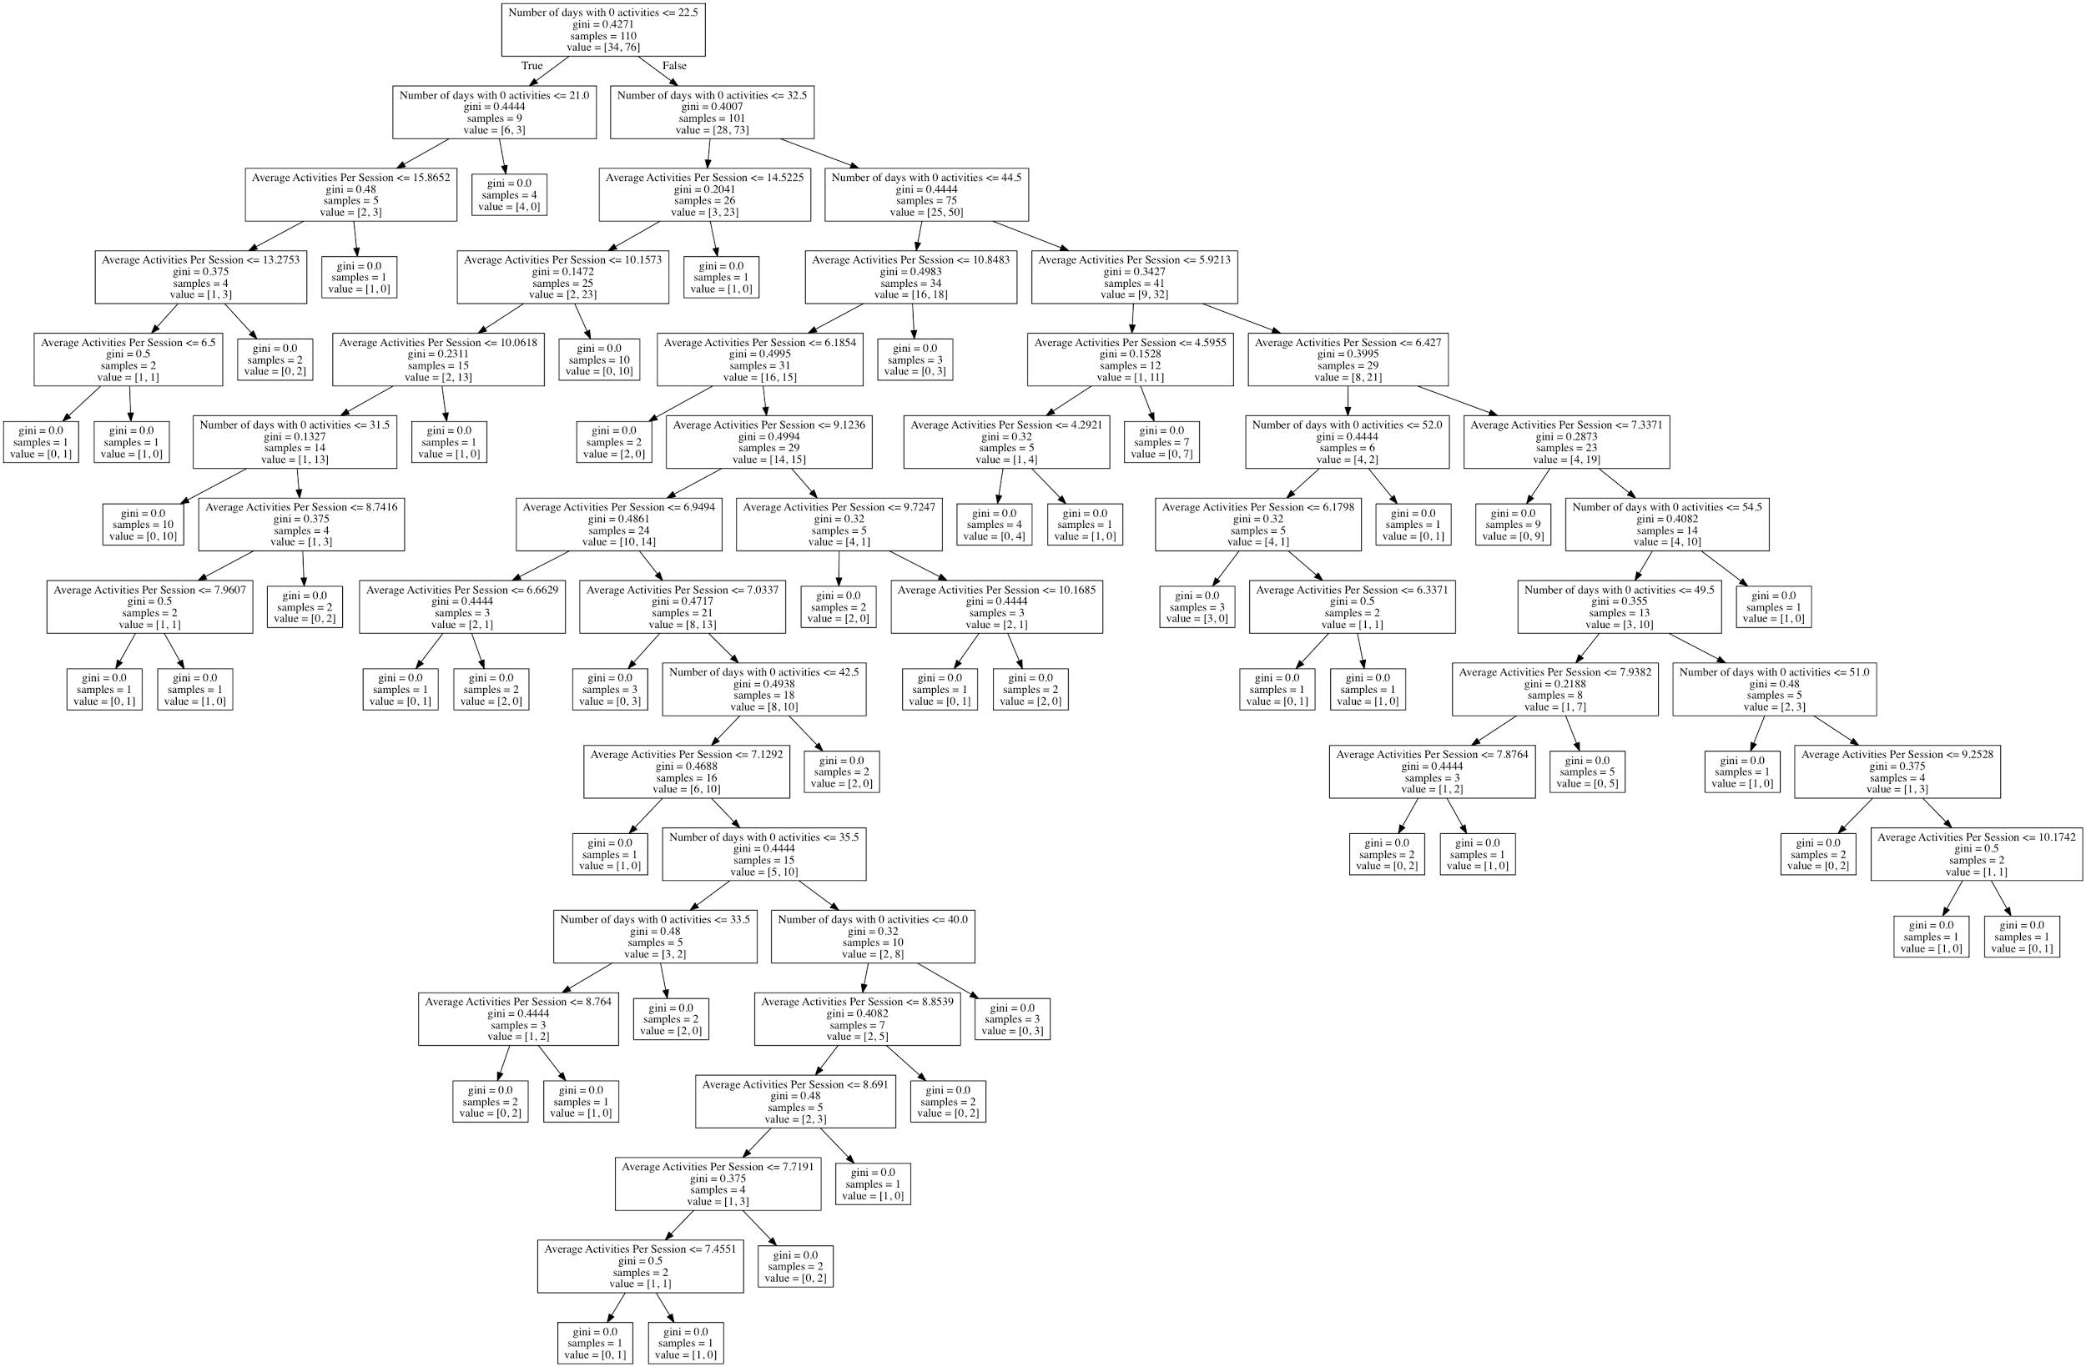
Readable Output models

Slide 7
Split data
Training and testing
Resemble Current and past semester

Slide 8
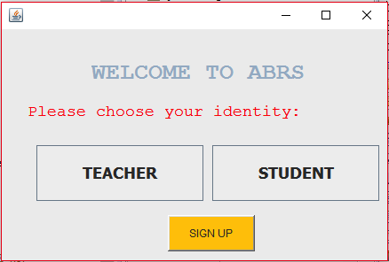
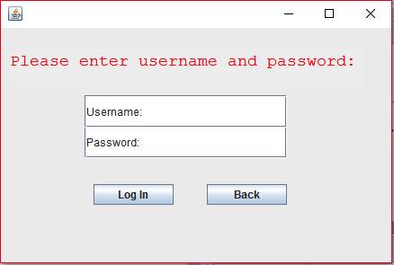
Complete GUI

Slide 9
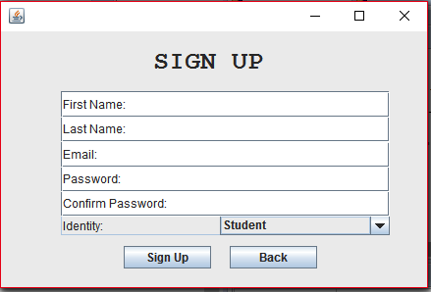
GUI

Slide 10
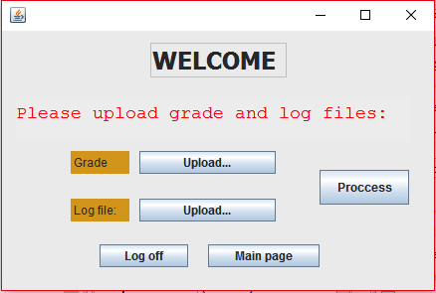
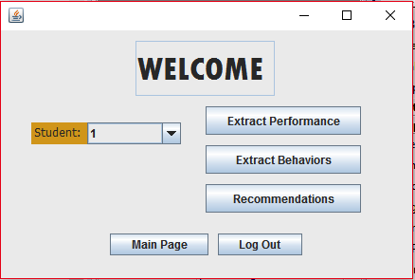
Teacher

Slide 11
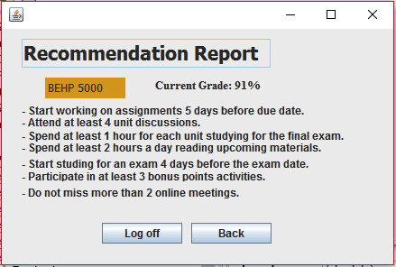
Teacher

Slide 12
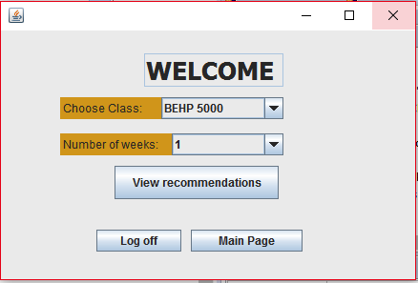
Student

Slide 13
Student

Slide 14
Plan for next milestone
Finish correlating and narrow down on data to be used for recommender
Reduce number of weeks for train and test

Slide 15
Questions?

